Slide 1

SAI VIDYA INSTITUTE OF TECHNOLOGY
Department of Computer Science and Engineering
Rajanukunte, Bengaluru - 560064
Internship Presentation on 31-05-2022
Lateral Load Analysis of moving train using FBG sensors
Internal Guide
Kshama S B
Assistant professor
CSE
Presented By
Tejas Manu S
1VA18CS052
External Guide
Guide Name
Designation
Department
2021-22

Slide 2
Presentation Outline
About the Organization.
About Department.
Task Performed.
References.
Dept. of ISE, SVIT

Slide 3
About The Organization
Lab to Market Pvt Limited is an IISc Startup imaging to make Railways safe and ensure No Accidents occur.
Founded in 2016 by Prof. S K Sinha and Mr G. S. Rao and a highly committed scientists.
Mission :
“To become a global leader in complex Cyber-Physical Systems for railways by building the most compelling technology company of the 21st century. We use our experience, know-how and ground-breaking R&D to develop highly innovative products/solutions to move closer to our customers and in turn to the people.”
Vision :
“To create safe, reliable, efficient and sustainable systems for your tomorrow through innovation”
Dept. of ISE, SVIT

Slide 4
About Department
Dept. of ISE, SVIT

Slide 5
Introduction
The project I worked on is the research and analysis of the data that is received by the Lateral Load Sensors and to check if we can find any trends.
Lateral load sensors are the FBG sensors placed on the sides of the track to measure the lateral load that is being exerted by the locomotive as it passes through the WILD site.
When there is any bad wheels or overloaded train, there are possibilities that, the lateral load might exert immense pressure and if the threshold is exceeded, there are possibilities the train might be de-railed.
We will be using the above mentioned lateral load sensors to analyse the data we receive, plot graph for the same.
This analysis will be done to check if we find any trends and if that data can be used to detect any overload or bad wheel of the locomotive.
This will help in alerting the Railways department using an automated message and mail. Hence resolve the issue beforehand before
Dept. of ISE, SVIT

Slide 6
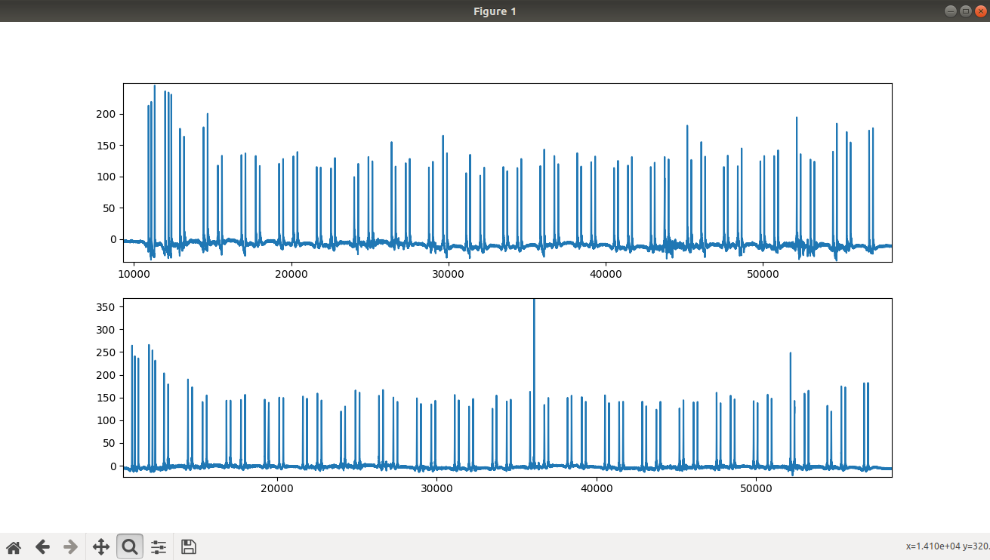
Lateral load sensor plot
There are 2 sensors placed on either side of each track. L1 and L2 on the left track gage, L3 and L4 on the right track gage.
In the above graph, first graph is plotted using the values of sum of L1 and L2 data and the second graph is plotted for the values of L3 and L4. Each peak in the above graph represents one axle.
In the above graph first six axles together form the first locomotive and the rest are wagons/coaches.
Dept. of ISE, SVIT

Slide 7
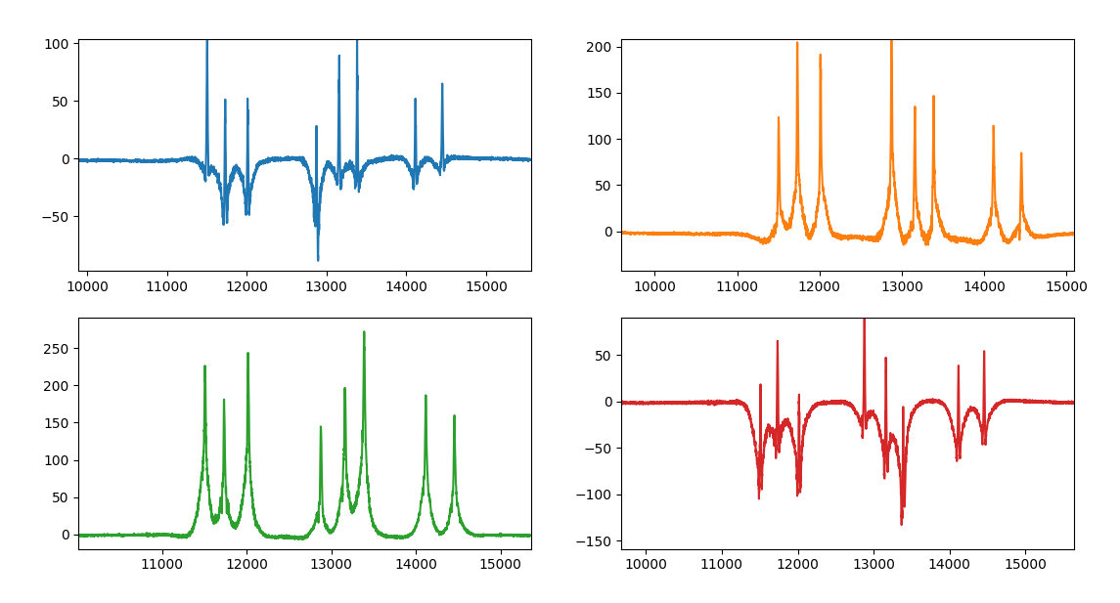
Individual Lateral Load Sensor Plot
Blue – L1
Orange - L2
Green – L3
Red – L4
We then plot graph for individual Lateral load sensors
The above graphs are plotted for L1, L2, L3 and L4 respectively.
Here we can observe the actual peak is not starting from 0, instead it goes towards the negative direction and then again raises towards the positive direction.
Hence we have to find the actual peak from the trough to crest.
Dept. of ISE, SVIT

Slide 8
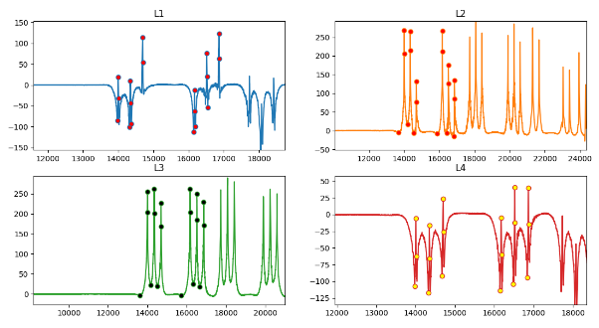
Marking peak values in sensor data
Here, we managed to mark the peaks of the first six axles in each lateral load sensor data, using this we will be able to find the actual peak value of each axle, even if decreases and then increases. Hence this value can be used instead of the previous peak values, as the peak values if taken from zero will give us incorrect trends.
Dept. of ISE, SVIT

Slide 9
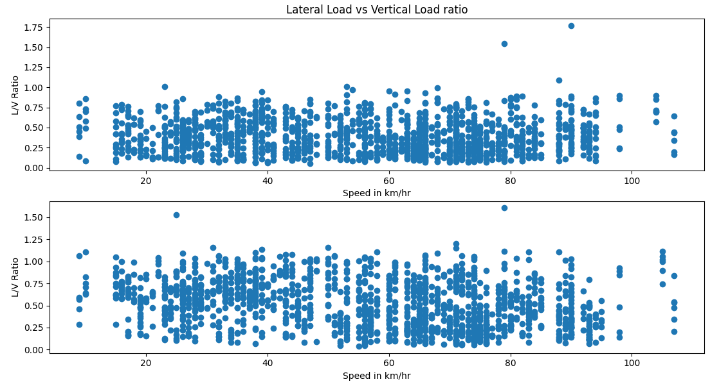
Vertical load vs Lateral load
We find the ratio of vertical load(L1+ L2) vs lateral load(L1- L2) using the peak values
Using these ratio we plot scatter plot for both L1,L2 and L3,L4 sensors
There are few points where the ratio is greater than 1, since the ratio shouldn’t be greater than 1, we will be ignoring those values to find any trend.
We don’t find any trend in the above plotted graph.
Dept. of ISE, SVIT

Slide 10
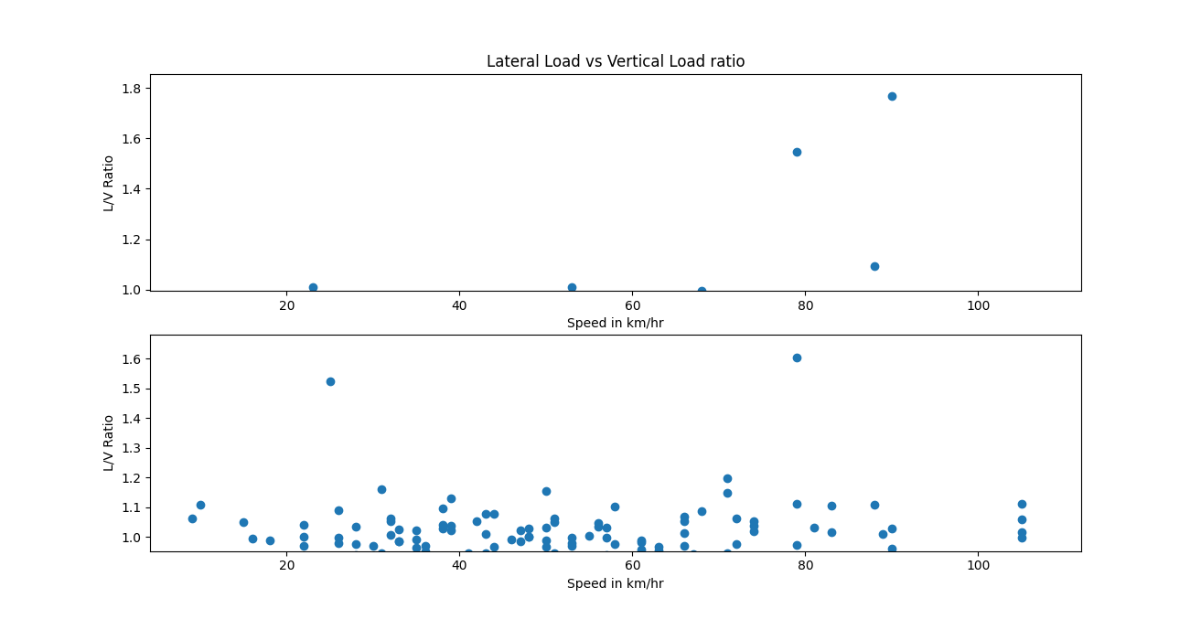
Outliers
In the above graph we can consider the values that are greater than 1
It is observed that there are few trains with ratio greater than 1 in the L1 and L2 data.
Whereas there are quite a few trains with ratio greater than 1, there are possibilities the sensors might be sending incorrect data or due to disturbances.
Dept. of ISE, SVIT

Slide 11
Analysis outcome
After cross verifying, we found out there were no issues with the calculation of ratio.
The problem was due to highly disturbed sensor data, which ended up giving false peaks
Many other methods were tried to eliminate those false peaks, but they are not successful.
This problem can be rectified if the disturbance is the sensor data is removed
Dept. of ISE, SVIT

Slide 12
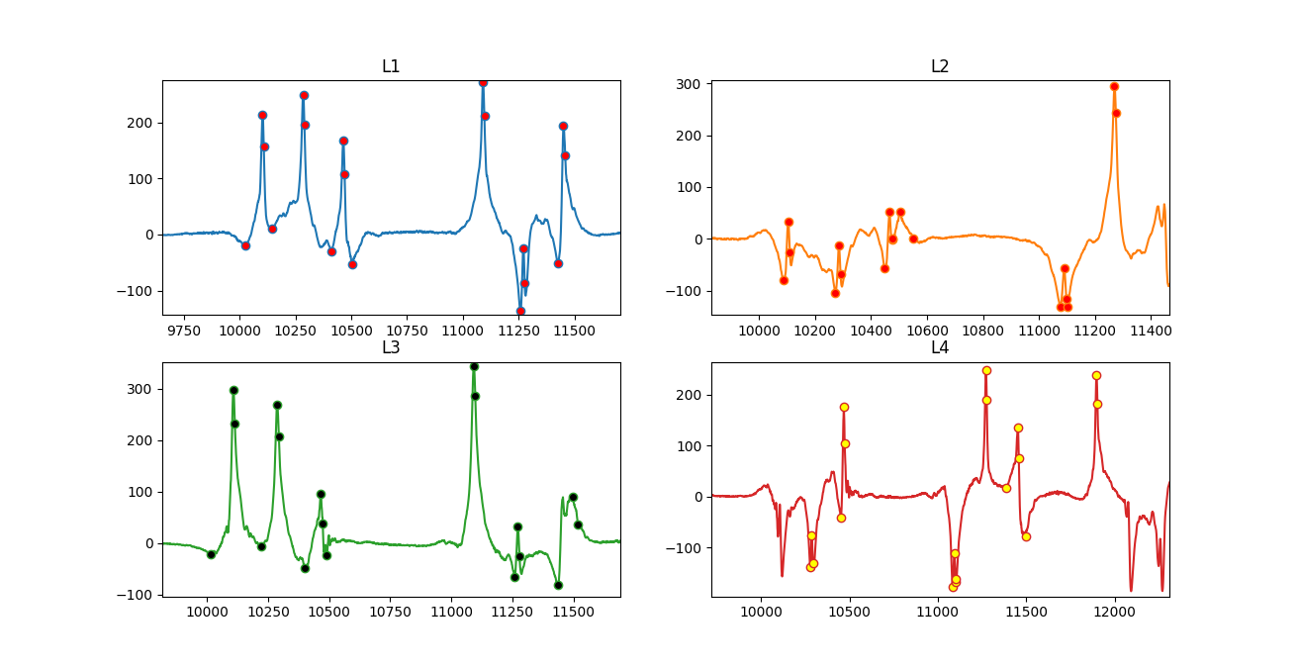
Observing the disturbance
The above graph shows the disturbance in the lateral load data.
There are many false peaks detected and in some places the peaks are not being detected at all
This is the reason we have been getting ratio greater than 1
Dept. of ISE, SVIT

Slide 13
Lateral vs Vertical analysis conclusion
Since there was no trend found in the peaks plotted, we conclude the sensor needs modification in order to reduce the disturbance and get correct data.
Next we will be calculating the speed of the train using the available data from the vertical load sensors.
Using that speed and peak values, we will be checking if there is any relation between these two parameters.
We will be checking and observing if there is any trend
Expected trend is that, there will be an increase in the lateral load value as the speed increases.
Dept. of ISE, SVIT

Slide 14
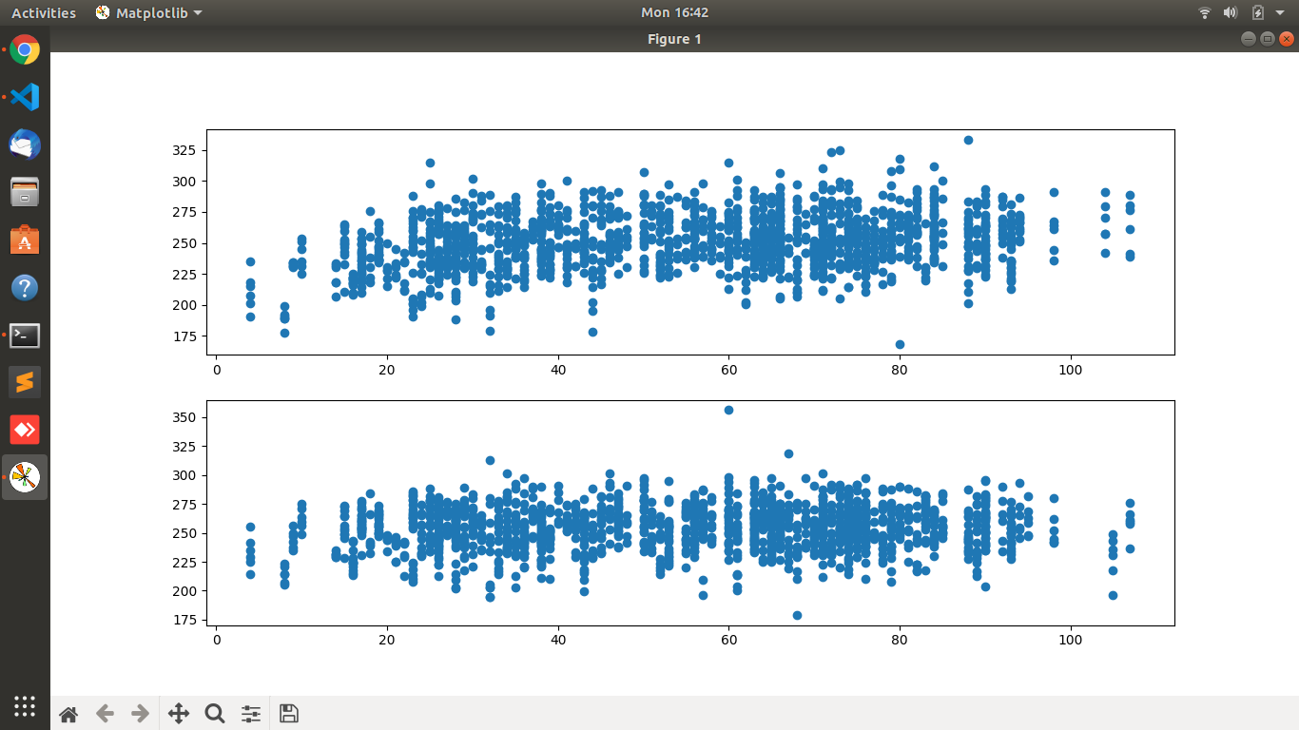
Peak values vs Speed
The above graph is a scattered graph in which peak value(sum of L1 & L2) plotted against speed.
Here it is observed that, there is a slight uptrend.
When the speed increased, there is an increase in the peak values.
Dept. of ISE, SVIT

Slide 15
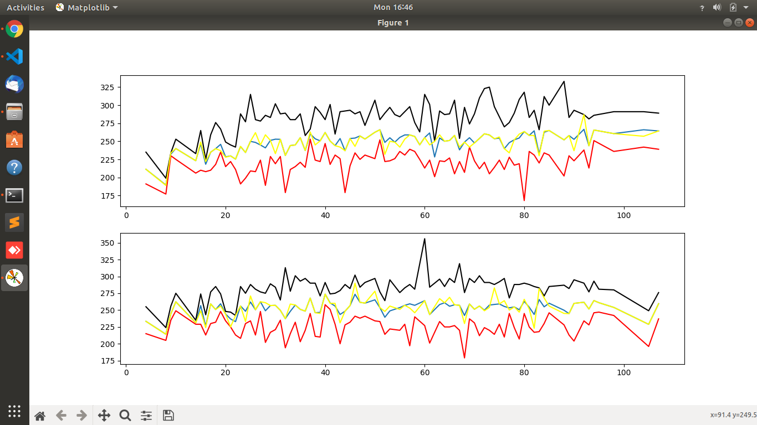
Statistics
Blue - Average
Black - Maximum
Red – Minimum
Yellow - Mode
Above graph is plotted peak value vs speed.
There is an very slight increase in the values as the speed increases
Hence an uptrend is noticed
Dept. of ISE, SVIT

Slide 16
Conclusion
There is not trend found in the Vertical load vs Lateral load, as there is an error in the data received due to high disturbance.
Hence we conclude there is no trend or relation found with the currently received data. The hardware modification is required to get smoother data.
When we compare and analyze the speed vs Lateral load data, we observe a slight up-trend.
Though there is not much major change in the values with respect to speed, we can use this information in the later stages when we obtain correct and smooth data from the Lateral load sensors
Dept. of ISE, SVIT

Slide 17
References
[1]. https://wiki.python.org/moin/BeginnersGuide
[2]. https://pandas.pydata.org/docs/reference/api/pandas.DataFrame.html
[3]. https://matplotlib.org/stable/index.html
[4]. https://stackoverflow.com/
[5]. https://www.geeksforgeeks.org/
[6]. https://www.w3schools.com/python/
Dept. of ISE, SVIT

